Slide 1

Week 4
Large-scale architectures
Fundamentals of IoT
Dr. Eoin Rogers (eoin.rogers@tudublin.ie)

Slide 2
Lesson Outline
Large-scale systems and their importance to modern IoT systems
System architectures common in IoT
Communication protocols commonly used in IoT systems
Cloud and fog computing

Slide 3
Large-scale systems
Software systems can grow extremely large

Slide 4
Large scale systems
Large scale systems are common in modern software development
Think of Google, Facebook, YouTube and other services
Although few systems grow this big, it is important to design systems in such a way that they can scale!

Slide 5
Ultra-large scale systems
Systems on the level of Google or TikTok would qualify as ultra-large scale systems (ULSS)
This is used in fields like CS, software engineering and systems engineering to refer to systems with unprecidented:
  Amounts of hardware
  Lines of code
  Numbers of users
  Volumes of data

Slide 6
Related fields
Systems analysis is concerned with identifying the goals and functionality of processes to create systems that can help achieve them
  Often, this involves breaking a system into parts that interact to acomplish a purpose (stepwise refinement)
Software engineering is the branch of engineering focused on software applications and systems

Slide 7
Complex systems
A complex system is a system composed of many interacting components
These systems are intrinsically difficult to model due to the complexity of the interactions of the components
They often exhibit emergent behaviour

Slide 8
IoT system architectures
IoT systems often qualify as large-scale systems

Slide 9
IoT system architectures
Because IoT devices are often small and low-end, they are often insufficient for any sort of complex code
We can get around this by outsourcing computation to an external system or environment
Therefore, it is useful to have some knowledge about how to categorise basic architectural patterns

Slide 10
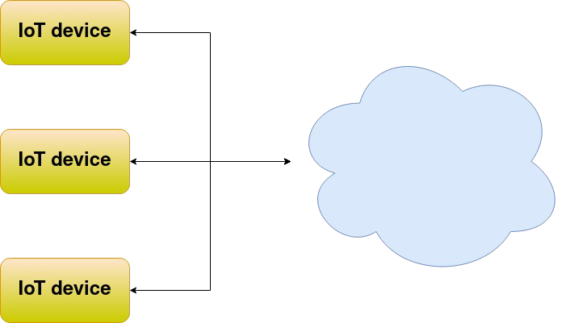
Device-to-cloud

Slide 11
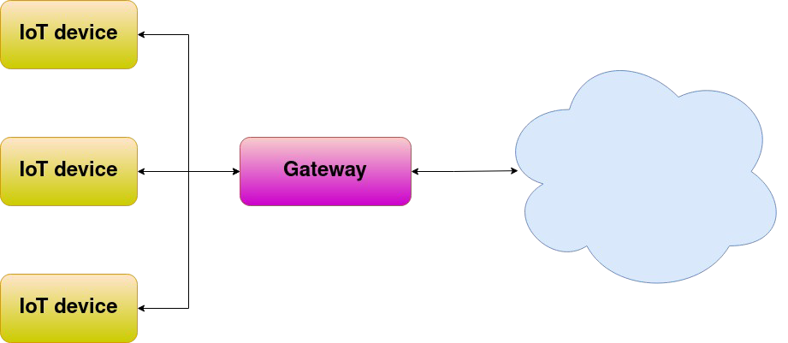
Device-to-gateway

Slide 12
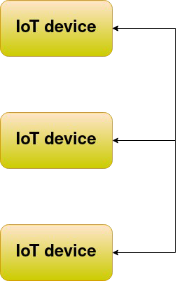
Device-to-device
A mesh network (or simply meshnet) is a local area network topology in which the infrastructure nodes (i.e. bridges, switches, and other infrastructure devices) connect directly, dynamically and non-hierarchically to as many other nodes as possible and cooperate with one another to efficiently route data to and from clients.

Slide 13
Communication protocols
Common ways for IoT devices to talk to the cloud

Slide 14
Communication protocols
The choice of communication protocol is often important – for example, it can have a major impact on both performance and security
Developing your own protocol is possible, but it is often frowned upon
  Can you think of why this is?

Slide 15
Protocols used in IoT
Two protocols are particularly commonly used in IoT systems:
  REST/RESTful APIs
  MQTT

Slide 16
Representational state transfer (REST)
Commonly used in both webdev and IoT
A stateless protocol making use of the client-server model
Runs on top of existing, common technologies
Typical example:
  JSON to serialise messages
  HTTP(S) to transmit them

Slide 17
REST basics
You talk to the server by sending JSON objects inside HTTP
The server will return JSON objects in its response
The protocol is connectionless/stateless (you need to authenticate each time, the server won’t remember you!)
  The server itself will usually have internal state!

Slide 18
Other properties of REST
The connectionless nature allows for caching
Commonly used with load-balancing, since it is a good fit for this
A uniform interface allows components to evolve independently of each other
Can use a trick called code-on-demand, where a server can send JS code to a client in response, so client-side computation can be extended dynamically 😬

Slide 19
Message queue telemetry transport (MQTT)
Originally developed for satellite communications (!)
Now commonly used for IoT
Works a bit like a WhatsApp group or mailing list – allows messages to be sent over a network between a peer machines, facilitated by a central server
  However, communication is generally one-way – one member of the group sends messages and others just read them!

Slide 20
MQTT terminology
Broker – The central server that runs the MQTT service
Topic – A single MQTT channel, much like a WhatsApp group or a mailing list
Publisher – A client in a topic that sends messages
Subscriber – A client in a topic that receives messages

Slide 21
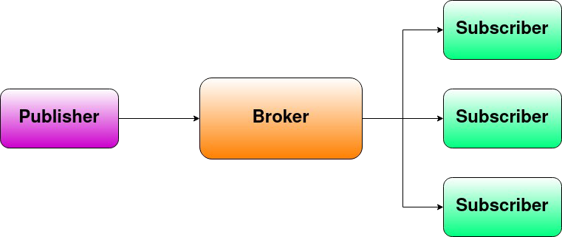
MQTT diagram

Slide 22
Cloud computing
IoT often (but not always!) utilises cloud computing

Slide 23
Cloud computing
With cloud computing, most processing occurs on a centralised server
This could be on-prem, or could be running on a third-party cloud service
  What might be some advantages and disadvantages of each approach?

Slide 24
Fog computing
Edge computing is a reaction to cloud computing, where computation is carried out locally on edge devices as much as possible
Fog computing is the use of architectures that make extensive use of edge computing
In fog computing, services are hosted close to where they are used: at the network edge or even at end devices!

Slide 25
Issues with cloud computing
Security
Privacy
GDPR
Vendor lock-in

Slide 26
Issues with fog computing
Higher up-front device cost
Higher power consumption (for users)
Higher device complexity (need to deal with firmware updates etc.)
More e-waste

Slide 27
Summary
Gave an overview of large-scale software systems, and why they are difficult to work with/on
Covered three types of architectural pattern common in IoT (device-to-cloud, -gateway and -device)
Covered both REST and MQTT as exemplar communication protocols
Talked about cloud vs. fog computing and advantages of each

Slide 28
9
That’s all for this week
Thanks for your attention!

